Slide 1
My Appointment
Android application powered by Firebase
By: Dondera Ionut-Catalin

Slide 2
Introduction
As your business grows, the time required by you to manage the clients appointments grows as well.
This is the moment where an application where clients can register accounts, check your business hours, get your contact information and make reservations can save you time and your business money.

Slide 3
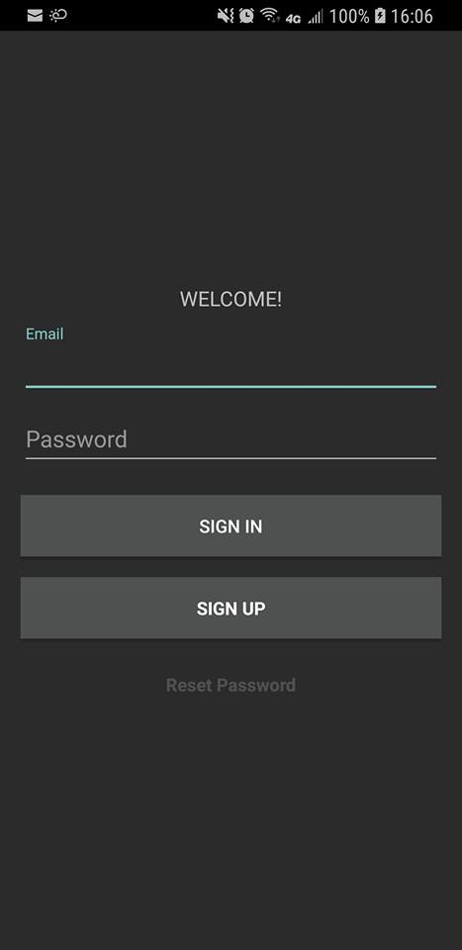
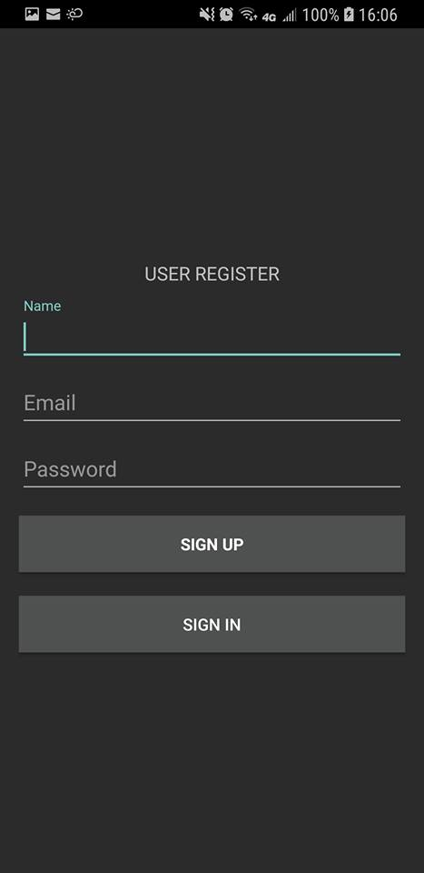
My Appointment is and android application made to ease the reservation process of the client for your business.
First run launches a simple login/register screen for your clients.

Slide 4
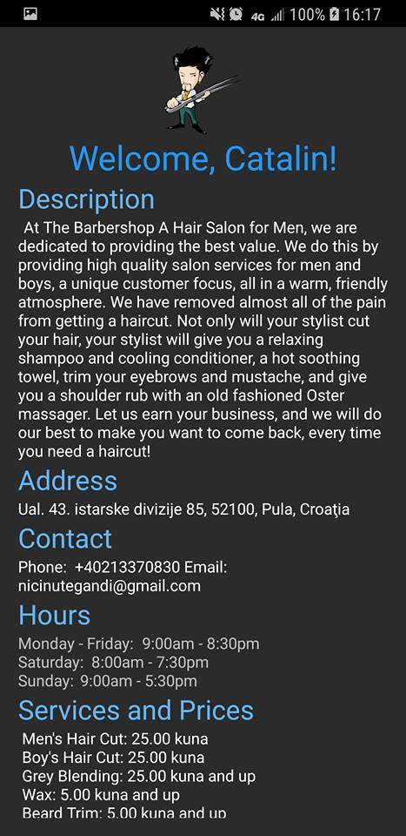
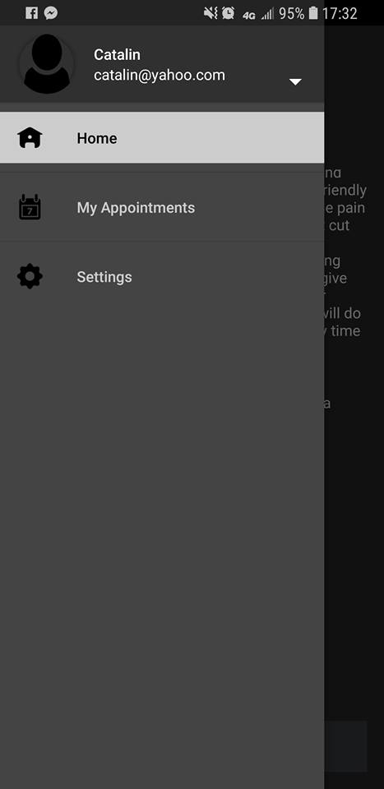
This format can be personalized for your business

Slide 5
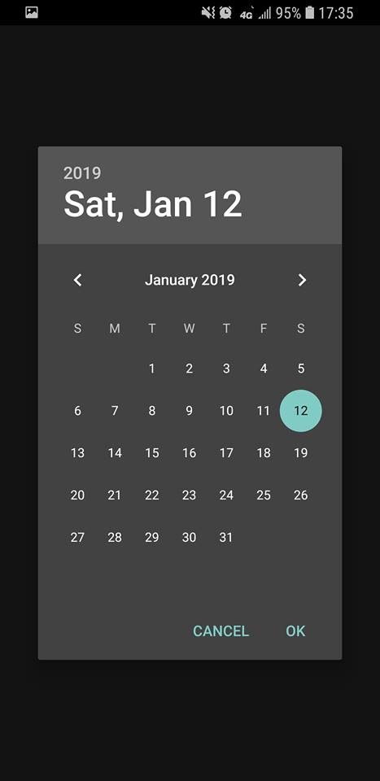
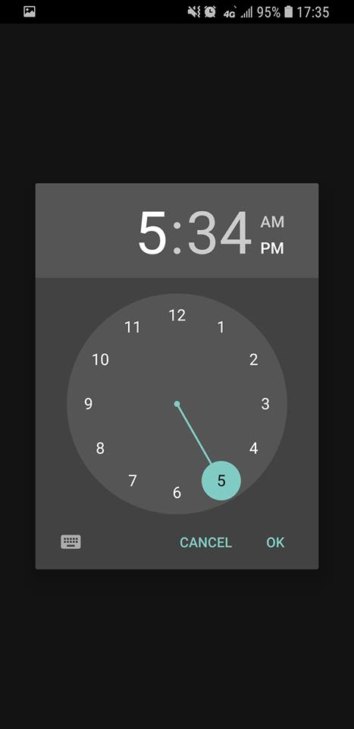
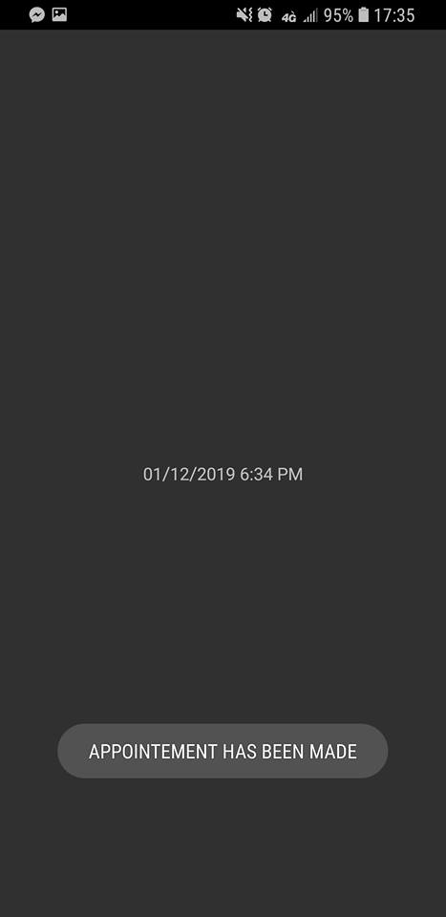
The booking process

Slide 6
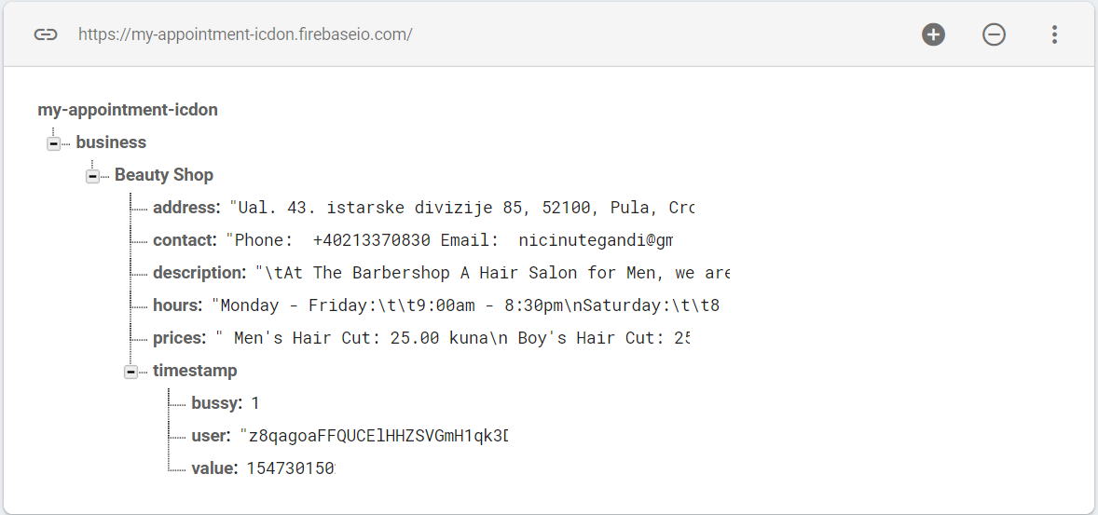
Key Benefits of Product or Service
Your data is stored in Firebase, Google's mobile platform that helps us quickly develop high-quality apps to grow your business.

